Slide 1
Introduction to Galaxy
Stéphanie Le Gras
(slegras@igbmc.fr)

Slide 2
Guidelines
Analyzing biological data with informatics tools
Presentation of the Galaxy project
Description of the main features of the Galaxy platform

Slide 3
Analyzing biological data with informatics tools

Slide 4





Bioinformatics analyses
Informatics data
Notes:
First, let’s talk about bioinformatics analysis. What do we mean by bioinformatics analyses? What do we need to perform such analyses? First of all we need a biological question.
Then from this question, one perform protocoles and wet lab experiments to get data. In this case, data are actually informatics data. Then to analyse and to get informations and answers out of it we need a bioinformatician who finally get answers to the question so that data can get published in a high level journal. Pushing the enter button can take months so let’s see what is behind and let’s talk about what bioinformaticians do.
so that data can get published in a high level journal. Pushing the enter button can take months so let’s see what is behind and let’s talk about what bioinformaticians do.

Slide 5
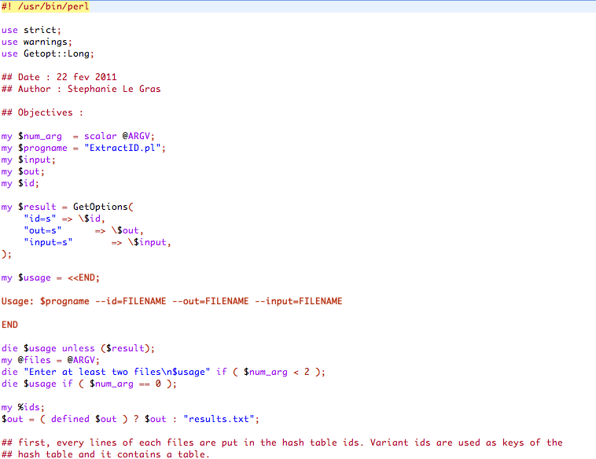
Bioinformatics analyses
Scripts, softwares
Command line
Notes:
Bioinformaticians try to address biological questions by creating or using very easy to understand scripts or programs such as the example script here. And to run those scripts and programs, we uselly don’t have any button on which to click but we have command lines.
So basically, the work of a bioinformatician is to use informatics tools

Slide 6
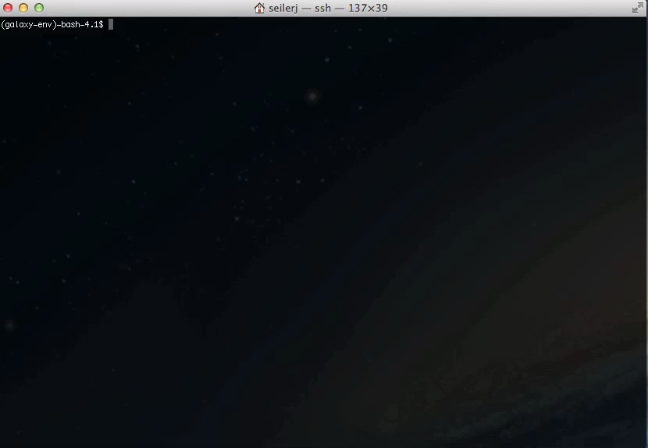
Bioinformatics analyses

Slide 7
Bioinformatics analyses
Program 1
Command line 1
Program 2
Command line 2
Program 3
Command line 3
Pipeline / Workflow
Program 4
Command line 4
…
…
Program n
Command line n
Notes:
One by one or queuing programs in the right order which is what we call a pipeline.
At the end of a pipeline, we can get the results. This is a schematic view of a bioinformatics pipeline. Real pipelines look much more like this :

Slide 8

Galaxy ?
Notes:
No no I’m not speaking about a galaxy but about Galaxy.

Slide 9


Slide 10
Galaxy project

Slide 11




What is Galaxy ?
Galaxy is a computing platform that enables people to run complex bioinformatics tools on a compute cluster through a simple web interface.
Notes:
Galaxy is an open web based platform for data intensive biomedical research. It is designed to perform, reproduce and share complete analyses. Basically, users can upload his own data to galaxy servers and run analyses on them. A lot of tools are available. Galaxy provides most of the tools designed for biological data analysis freely available on the web as for NGS data analysis with the NGS toolbox. Users can build their own analysis pipeline by queuing several tools and it can be done with a user friendly interface. A lot of people are using it world wide. Users can share their own workflows or download the other’s ones. Galaxy is completely free and available on a remote instance on the web. We can also download it to get it installed locally. You can even install it on your laptop. Of course the analysis you’ll be able to run will thus depend on the power of your computer. Now let’s see how Galaxy work. Let’s first imaging a researcher who wish to analyze his own data. This researcher is from the IGBMC

Slide 12
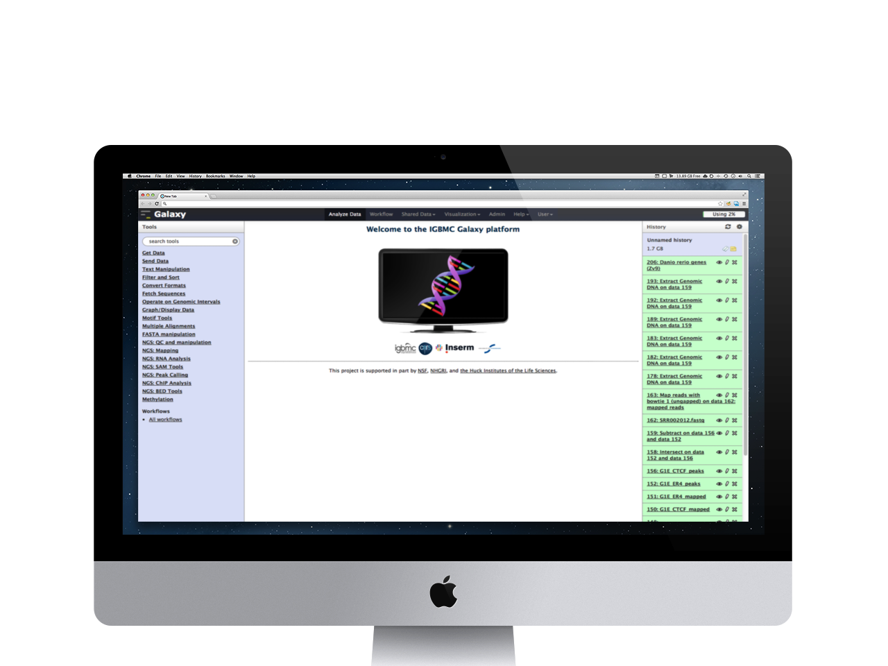
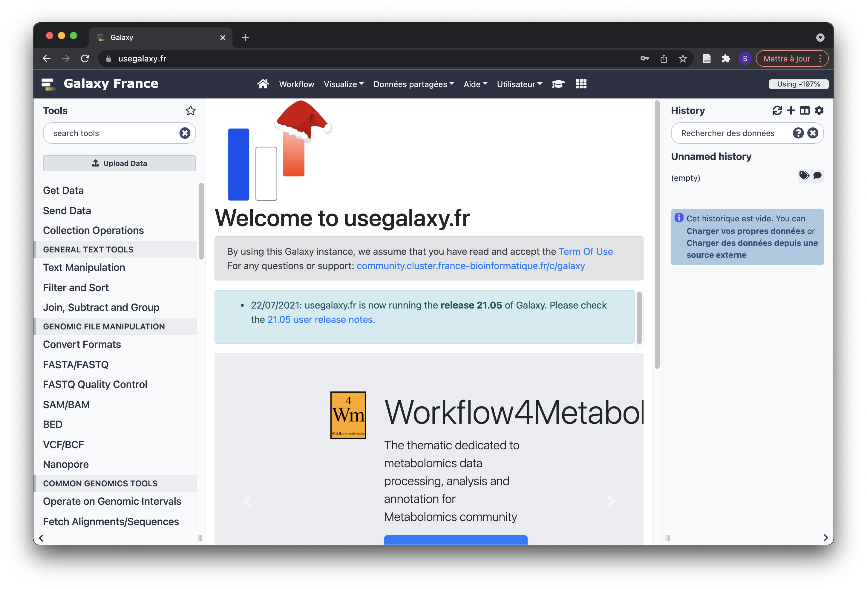
This is Galaxy

Slide 13
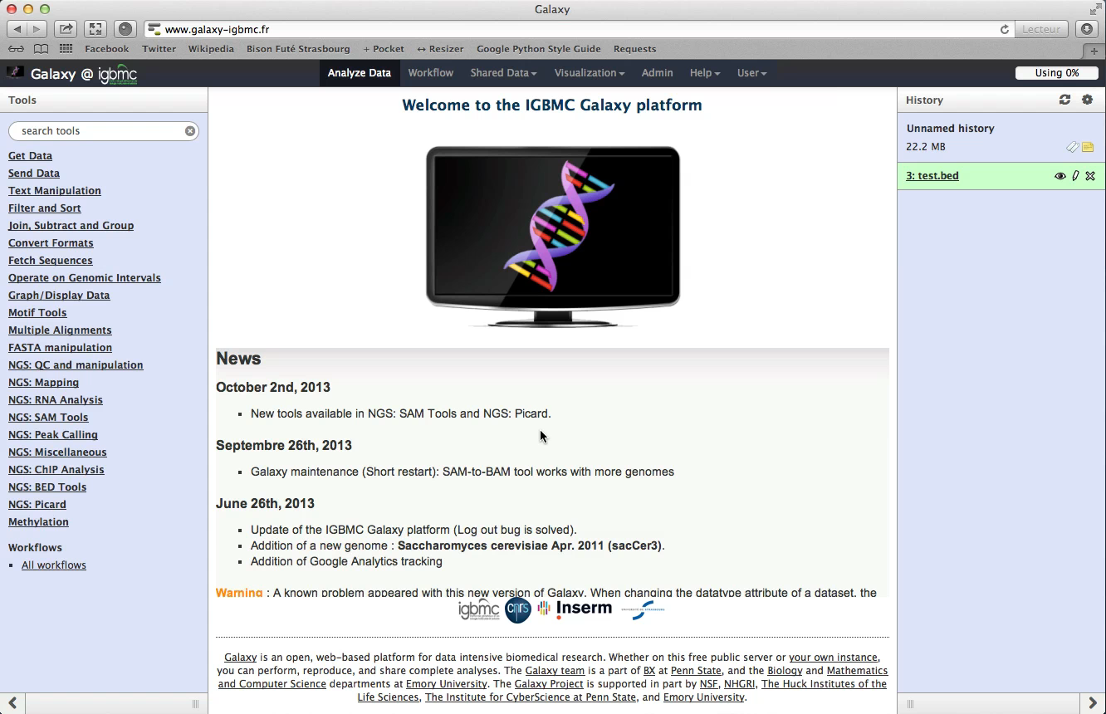
Running analyses with tools
Notes:
WorkflowsTools for automating bioinformatics analyses

Slide 14
Galaxy philosophy
Perform, and share complete analysis
No programming skills required
Open source and free solution
Very large and active community
Reproducibility/Usability/Transparency

Slide 15
How to use Galaxy

Slide 16
Use Galaxy
Public servers
Local servers
Clouds (Public, Commercial or Academic)
Docker
Virtual Machines

Slide 17
Galaxy public servers
Galaxy Project's public server (https://usegalaxy.org/) (3)
There are several public remote Galaxy instances worldwide (160)
Genomics Servers
Domain Servers
Tool Publishing Servers
Public Galaxy Servers list : https://galaxyproject.org/use/
Last Update on: 2020, December 16th

Slide 18




Galaxy public servers
All analyses are run on remote computing infrastructures
No need to have a Supercomputer to use Galaxy
Web browser

Slide 19
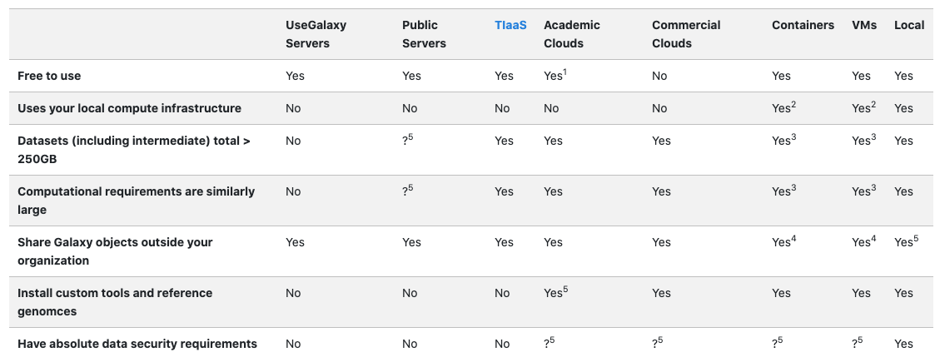
Use Galaxy
* TIaaS: Training Infrastructure as a Service
https://galaxyproject.org/use/
171 resources for using Galaxy (Last Update on: 2021, June 7th)

Slide 20

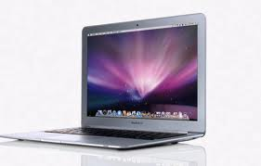


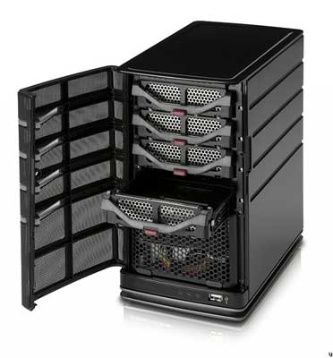
Galaxy public servers
Your research institute
Connect to Galaxy web site through a web browser
(https://usegalaxy.org/)
Download and upload of the data
Remote instance of Galaxy
Run analyses

Slide 21
Galaxy public servers
World wide
Your research institute
Download and upload of the data
Remote instance of Galaxy
Uploading (takes a lot of time)
Shared computing power (longer analysis)

Slide 22
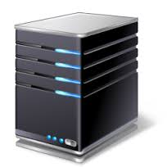
Galaxy local server
Run a local production Galaxy because you want to
install and use tools unavailable on public Galaxies
use sensitive data (e.g. clinical)
process large datasets that are too big for public Galaxies
Develop Galaxy tools
Develop Galaxy itself

Slide 23
Description of the main features of Galaxy

Slide 24
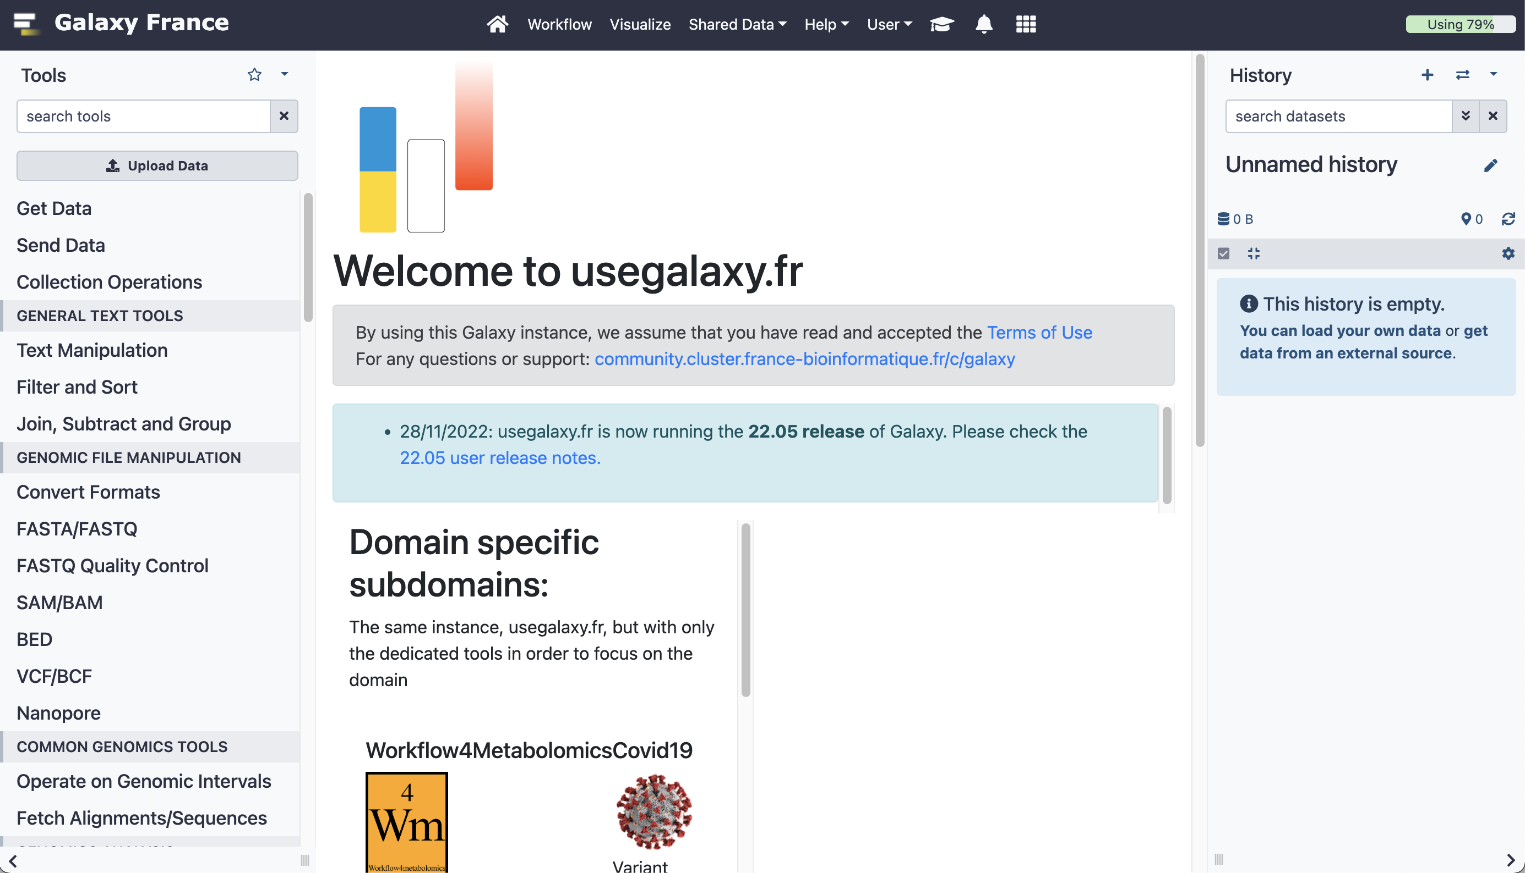
Galaxy web interface
Top menu
Tool
panel
Data display and tools dialog window
History panel

Slide 25
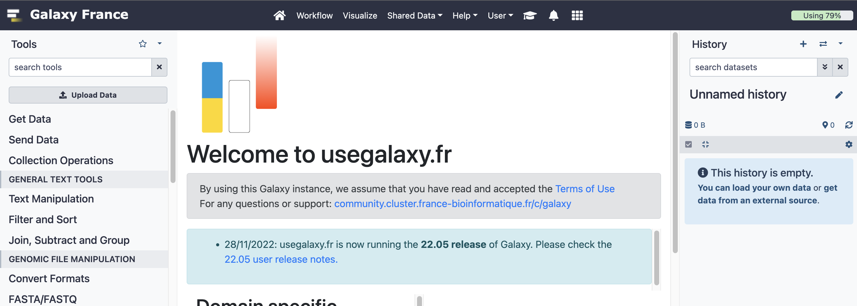
Top menu
Run
workflows
Access public data
Get Help
Get access to training materials
Run
analyses
Log in/out, manage your account

Slide 26
Exercise 1

Slide 27
History
History panel
Keep track of each job run

Slide 28
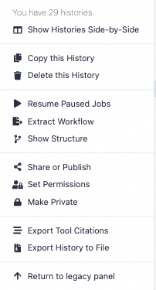
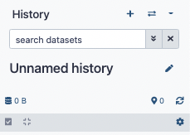
History
History options
Switch history
Create new history
Search datasets
History name
Refresh History

Slide 29
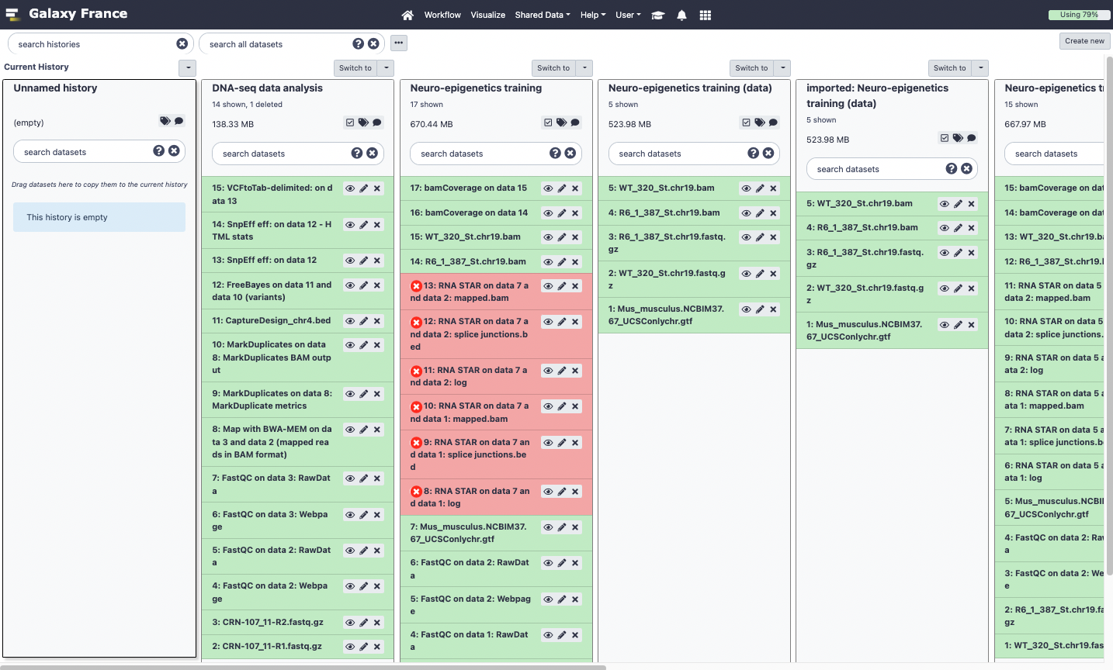
View all histories

Slide 30
Exercise 2

Slide 31
Import data into Galaxy
Your own data (from your computer)
Shared data
Data from external sources

Slide 32
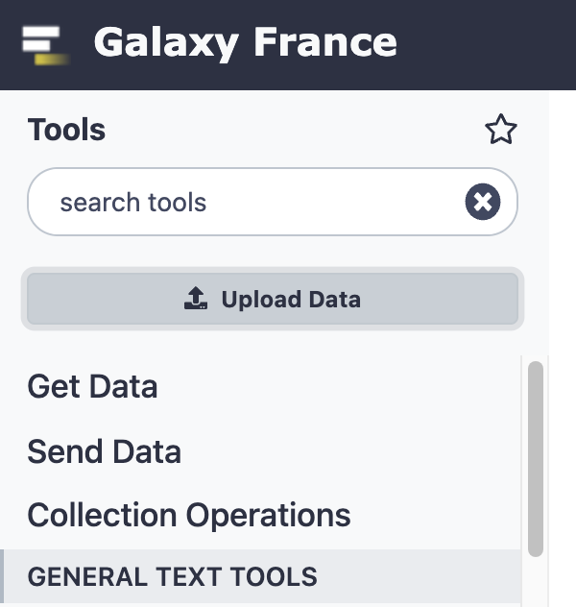
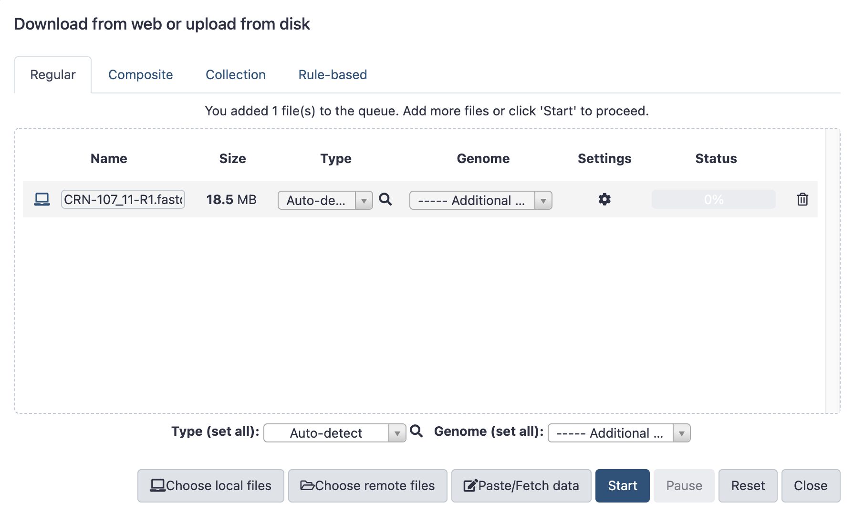
Import your own data to Galaxy
Display the drag and drop utility used to upload local files
Name of the dataset
Size of the dataset
File format
Genome

Slide 33
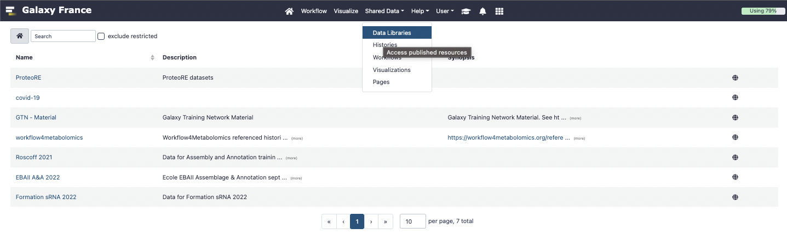
Import shared data (data libraries)
1.
2.
List of data
libraries

Slide 34
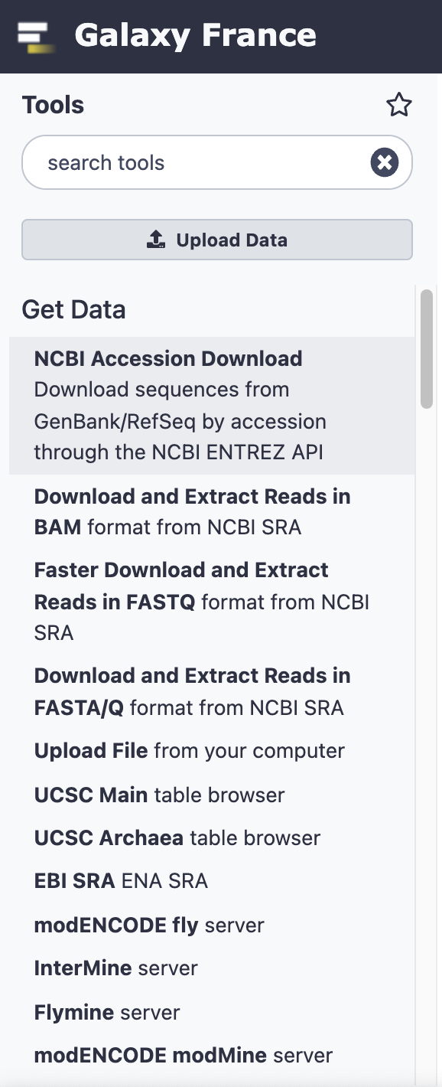

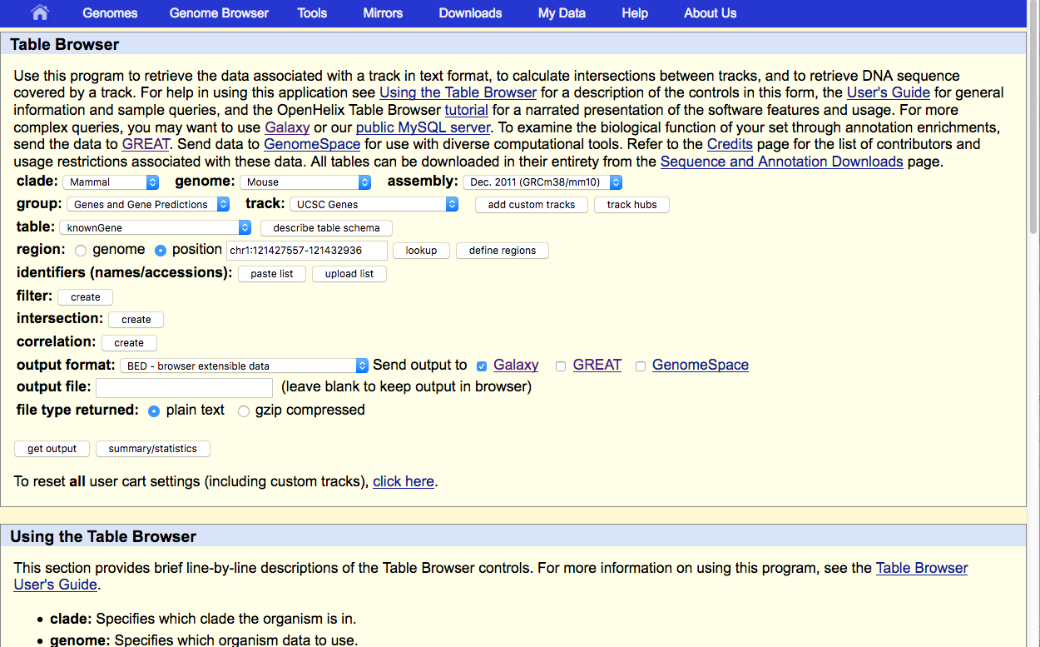
Import public data
Browse and import external data from public databases

Slide 35
Exercise 3

Slide 36



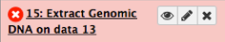
Datasets/Jobs in the History
Grey: the job is waiting to run
Orange: the job is running
Green: the job is successfully done
Red: the job encountered a problem

Slide 37
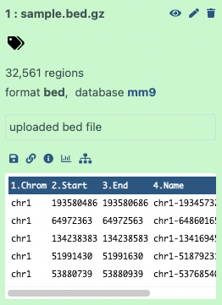
Datasets/Jobs in the History
Number of lines in the file or size of the file
Format
Genome
If the dataset is a text file, the first lines of the file are displayed

Slide 38
Datasets/Jobs in the History
View dataset (if possible) in the middle panel of Galaxy
Delete dataset
Edit attributes of the dataset (change name, format, genome, permission)
Download dataset

Slide 39
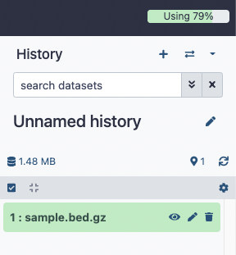
Size of histories and quota
Size of history
Quota

Slide 40
Exercise 4

Slide 41
Tool Panel / Run analyses
Tool
panel

Slide 42
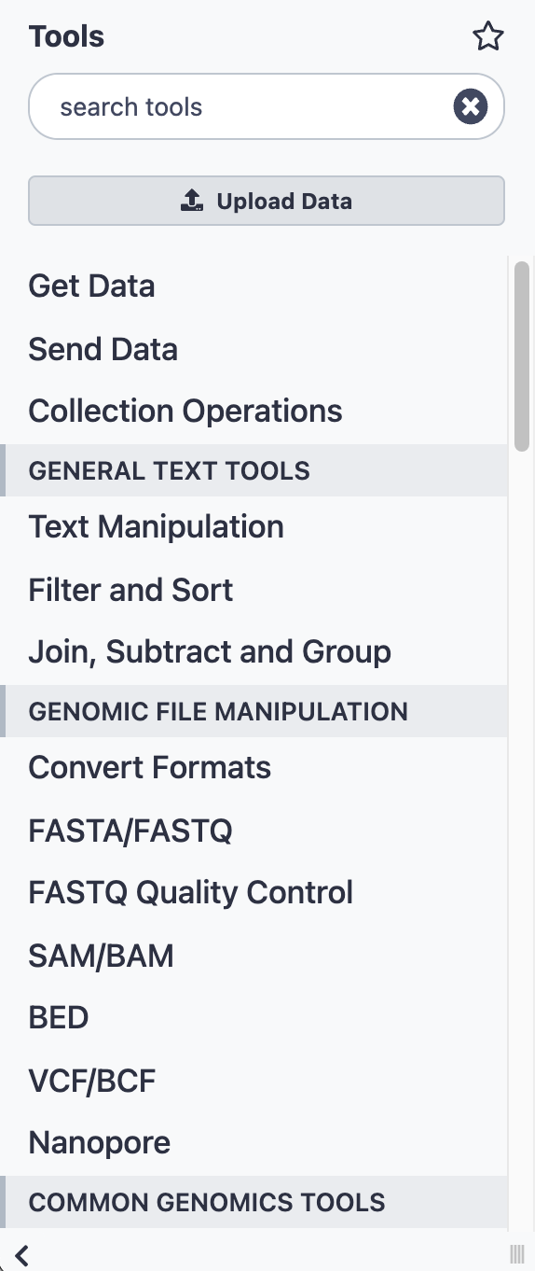
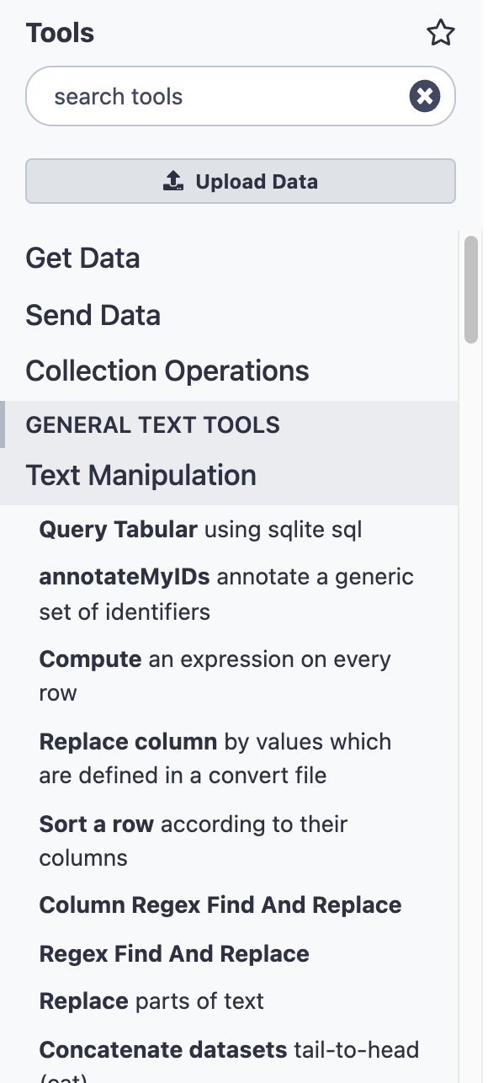
Tool Panel / Run analyses
Upload data
Search a tool
Tool
Tool category

Slide 43
Tools dialog window
Data display and tools dialog window
Set parameters
Run tools
Get help on tools
Display content of dataset

Slide 44
Exercise 5

Slide 45
Exercise 6

Slide 46
Workflow

Slide 47
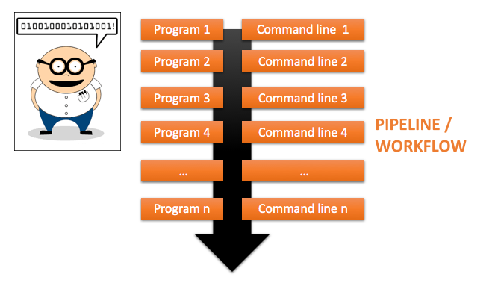
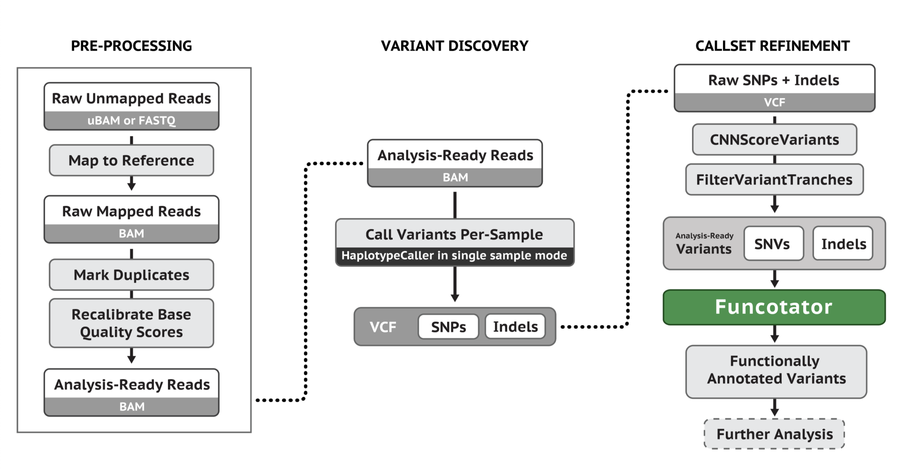
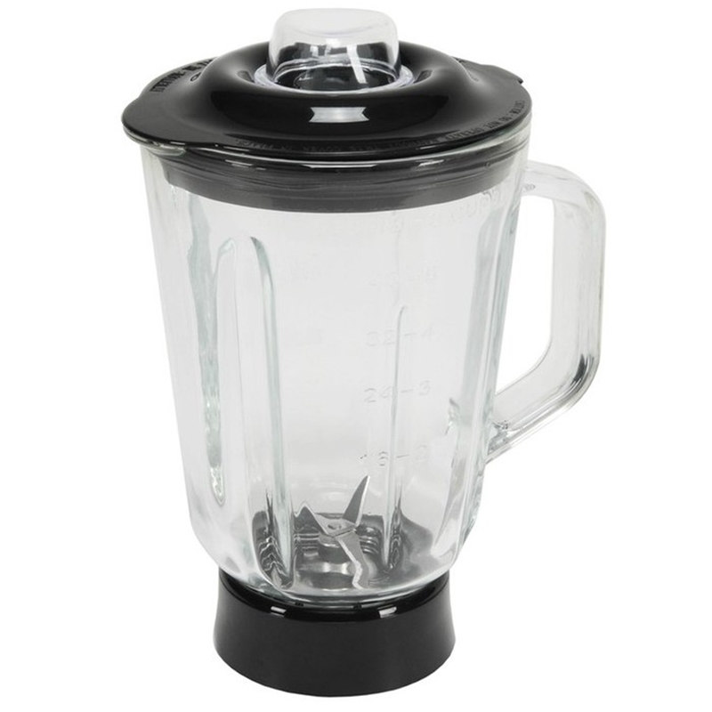
What if we’d mix all together

Slide 48
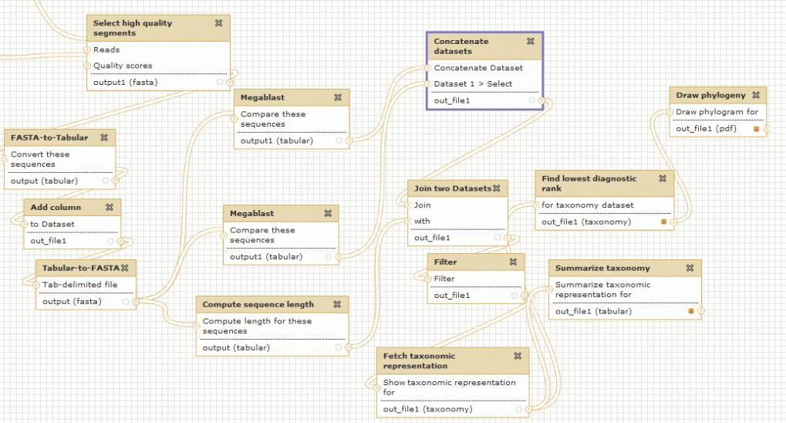
Galaxy workflow

Slide 49
Galaxy workflows
Workflow:
Analysis protocol with several steps (tools)
The output of a step is used as the input of the next next so file formats between two steps should be compatible!
Workflows are often made general so that they can be run on various datasets
Some of the parameters are pre-defined while others are set at runtime

Slide 50
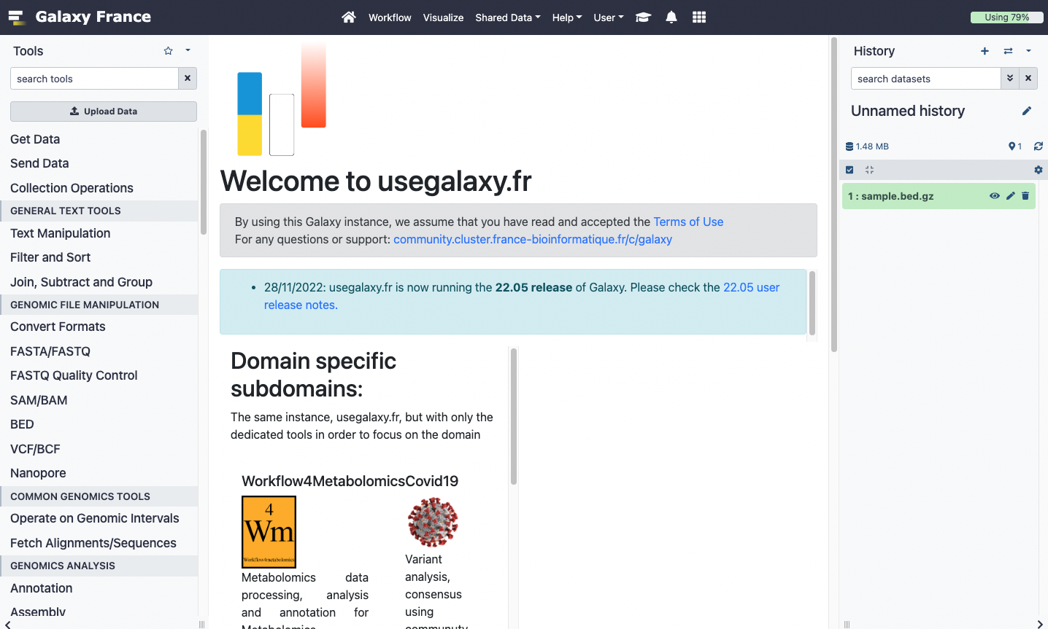
Workflows
Create, run, edit (…) workflows

Slide 51
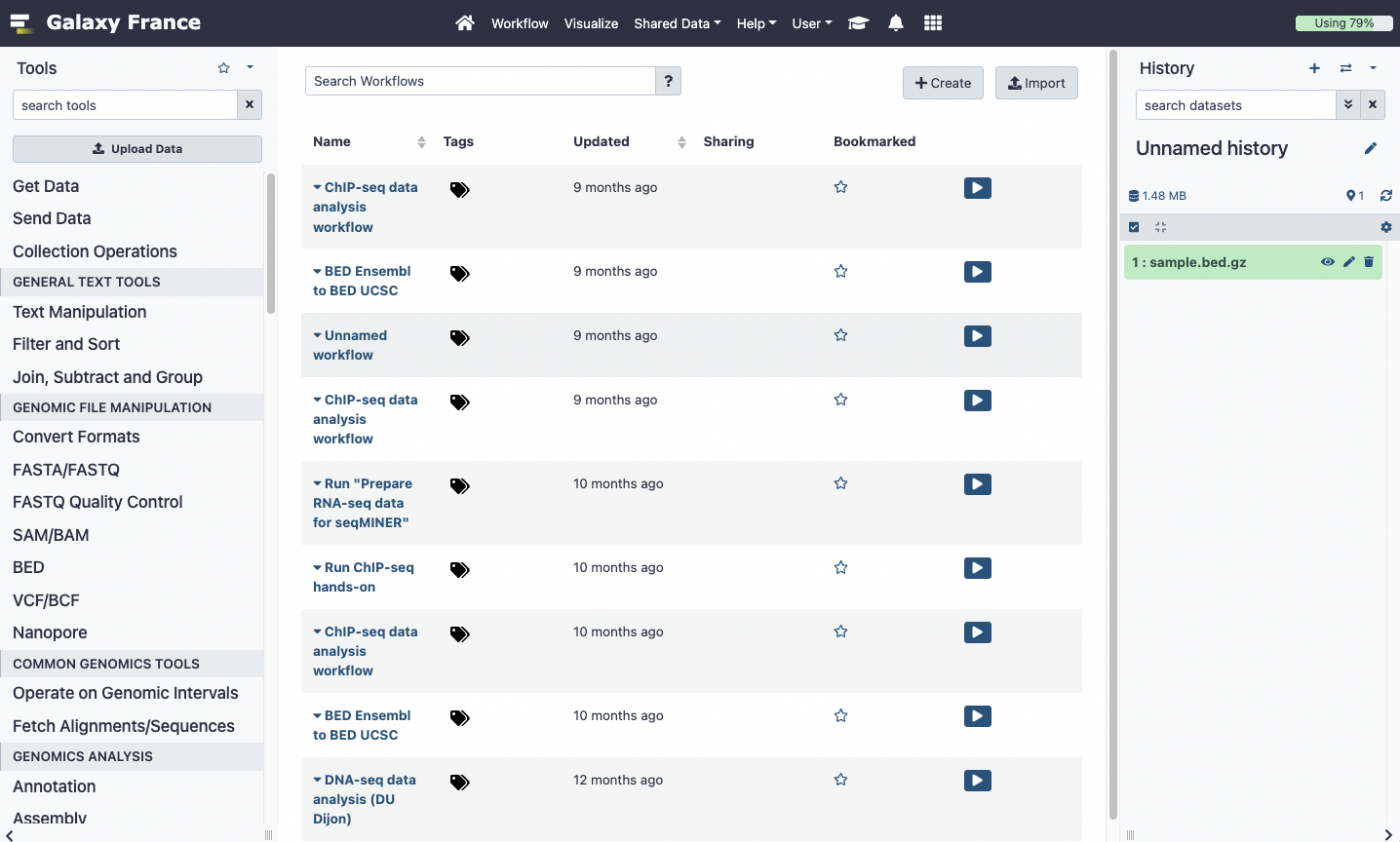
Workflows
Create workflows
List of Workflows

Slide 52
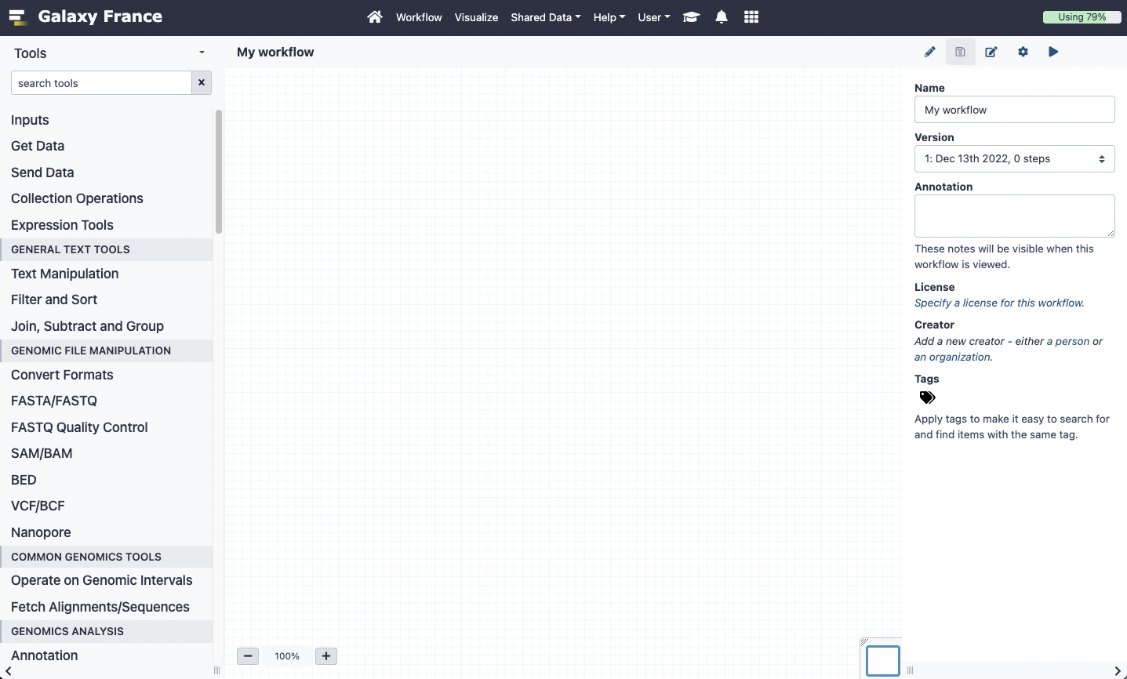
Workflow creation
Add tools or input datasets to the workflow

Slide 53
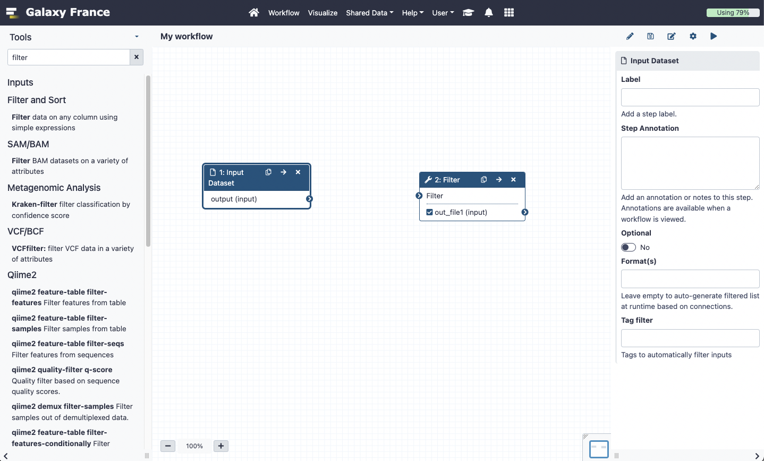
Workflow creation
Input dataset.
Most of the time, a workflow starts with an input dataset to which analyses are applied. In Galaxy, the file format of the input dataset will be limited to the input file format of the subsequent step
Tool to be run

Slide 54
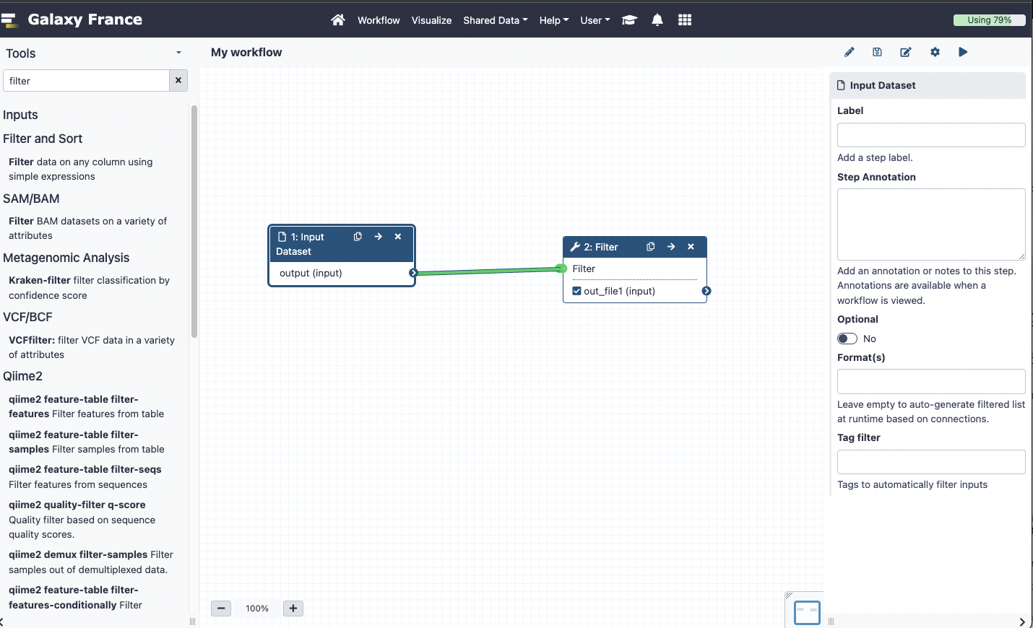
Workflow creation
If two steps can be linked together, the link between the two boxes is green

Slide 55
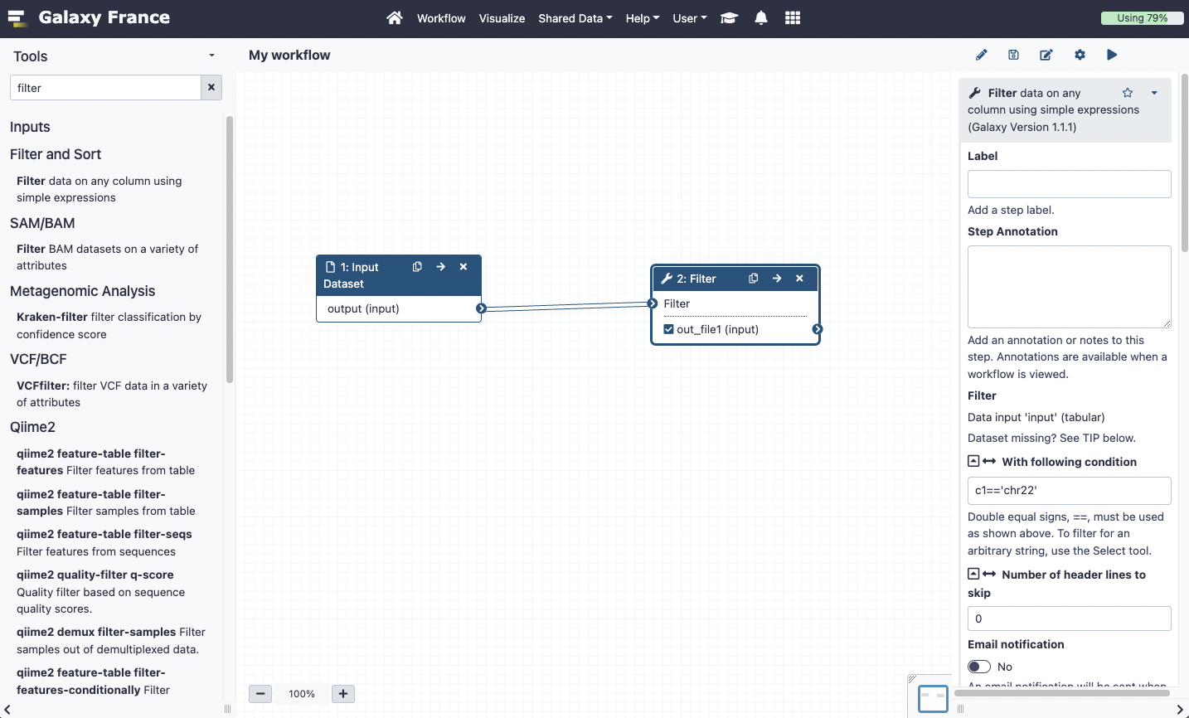
Workflow creation
Pre-configure tool parameters and configure parameters to be set at run time

Slide 56
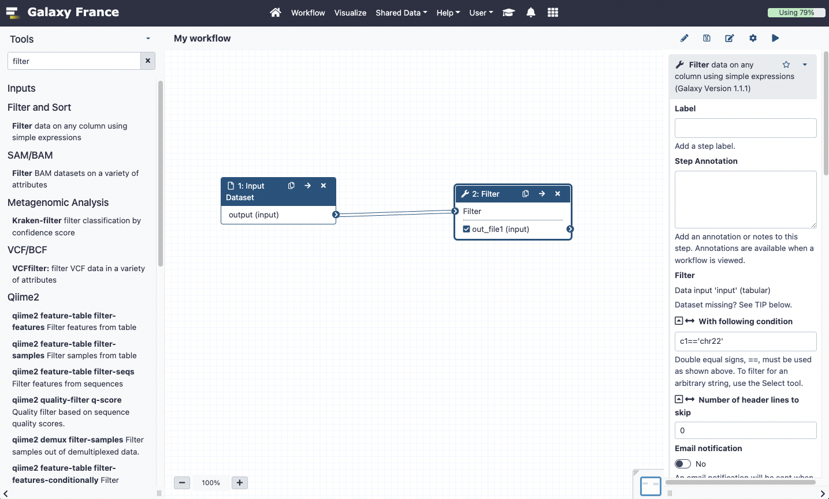
Workflow creation
Run
Save workflow

Slide 57
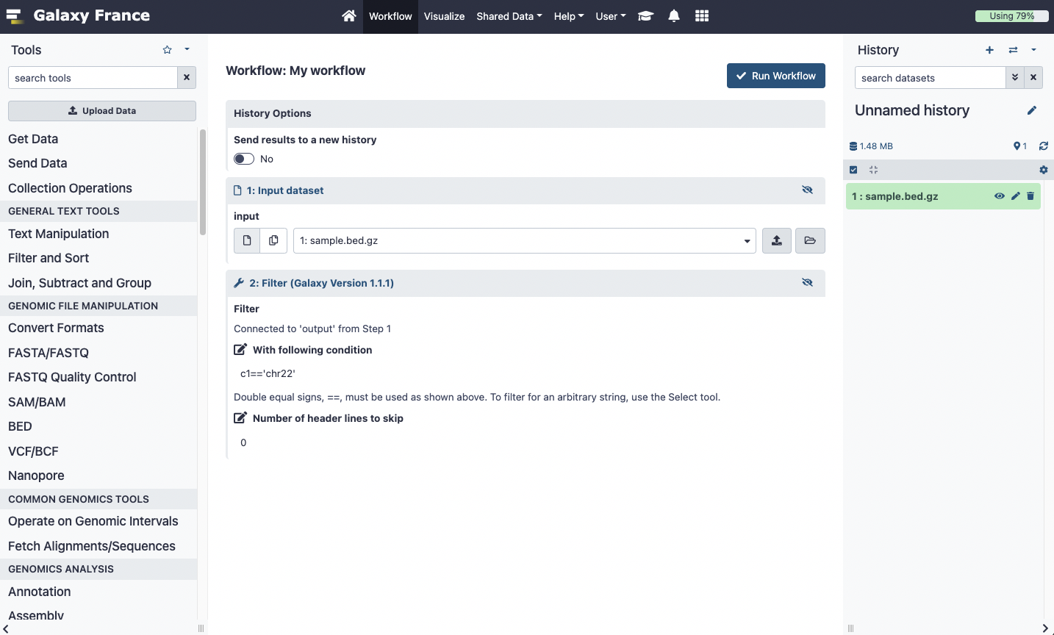
Run workflows
Set input file(s). It has to be a dataset from your current history
Run workflow
Set parameters

Slide 58
Exercise 7

Slide 59
Exercise 8

Slide 60
Exercise 9

Slide 61
Privacy
By default datasets, workflows, histories are private to the user that generated/uploaded them.
They can be shared across Galaxy users (of the same Galaxy instance) or via links

Slide 62
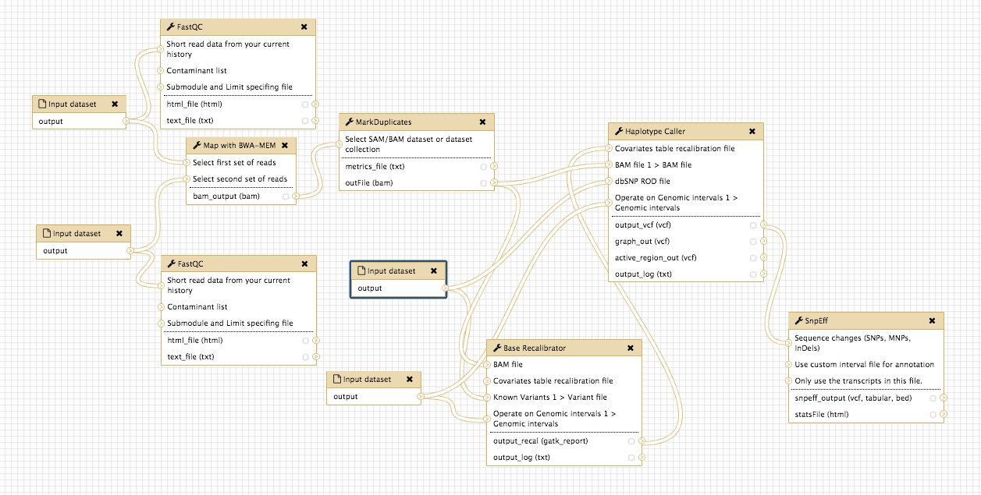
QC
Read 1
Duplicates marking
Variant calling
Read 2
Mapping
Capture design
dbsnp
Variant
annotation
Base recalibration

Slide 63
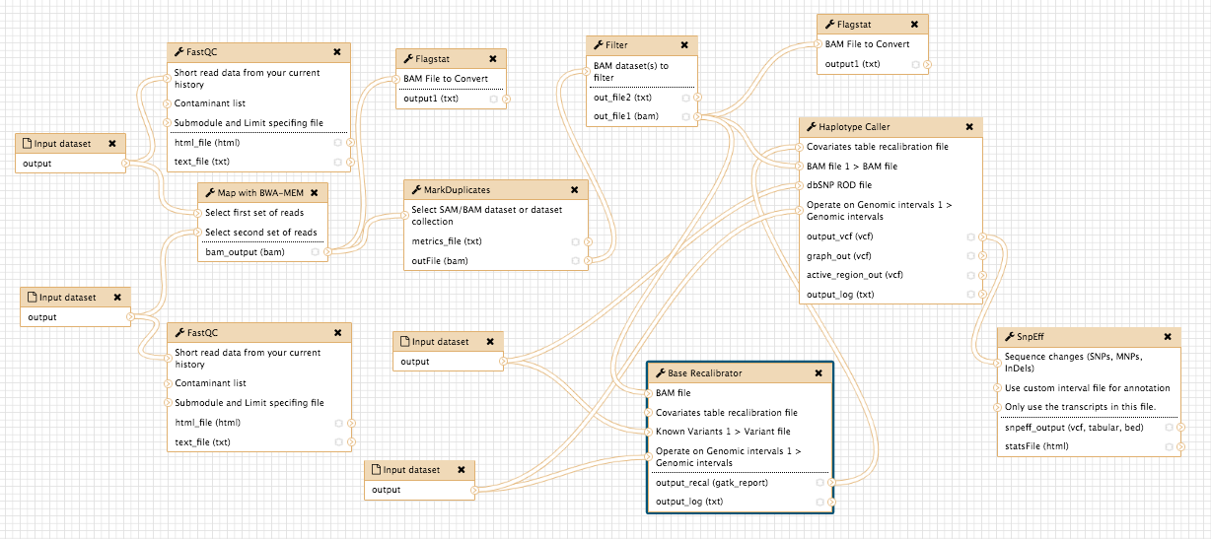
QC
Variant calling
Read 1
Duplicates marking
Read 2
Mapping
dbsnp
Capture design
Variant
annotation
Base recalibration

